Slide 1
Chapter 2 Elementary Programming

Slide 2
Motivations
In the preceding chapter, you learned how to create, compile, and run a Java program. Starting from this chapter, you will learn how to solve practical problems programmatically. Through these problems, you will learn Java primitive data types and related subjects, such as variables, constants, data types, operators, expressions, and input and output.

Slide 3
Objectives
To write Java programs to perform simple computations (§2.2).
To obtain input from the console using the Scanner class (§2.3).
To use identifiers to name variables, constants, methods, and classes (§2.4).
To use variables to store data (§§2.5–2.6).
To program with assignment statements and assignment expressions (§2.6).
To use constants to store permanent data (§2.7).
To name classes, methods, variables, and constants by following their naming conventions (§2.8).
To explore Java numeric primitive data types: byte, short, int, long, float, and double (§2.9.1).
To read a byte, short, int, long, float, or double value from the keyboard (§2.9.2).
To perform operations using operators +, -, *, /, and % (§2.9.3).
To perform exponent operations using Math.pow(a, b) (§2.9.4).
To write integer literals, floating-point literals, and literals in scientific notation (§2.10).
To write and evaluate numeric expressions (§2.11).
To obtain the current system time using System.currentTimeMillis() (§2.12).
To use augmented assignment operators (§2.13).
To distinguish between postincrement and preincrement and between postdecrement and predecrement (§2.14).
To cast the value of one type to another type (§2.15).
To describe the software development process and apply it to develop the loan payment program (§2.16).
To write a program that converts a large amount of money into smaller units (§2.17).
To avoid common errors and pitfalls in elementary programming (§2.18).

Slide 4

Introducing Programming with an Example
Listing 2.1 Computing the Area of a Circle
This program computes the area of the circle.
ComputeArea
Animation
Run
IMPORTANT NOTE: If you cannot run the buttons, see www.cs.armstrong.edu/liang/javaslidenote.doc.

Slide 5
Trace a Program Execution
animation
allocate memory for radius
public class ComputeArea {
/** Main method */
public static void main(String[] args) {
double radius;
double area;
// Assign a radius
radius = 20;
// Compute area
area = radius * radius * 3.14159;
// Display results
System.out.println("The area for the circle of radius " + radius + " is " + area);
}
}
radius
no value

Slide 6
Trace a Program Execution
animation
public class ComputeArea {
/** Main method */
public static void main(String[] args) {
double radius;
double area;
// Assign a radius
radius = 20;
// Compute area
area = radius * radius * 3.14159;
// Display results
System.out.println("The area for the circle of radius " + radius + " is " + area);
}
}
memory
radius
no value
area
no value
allocate memory for area

Slide 7
Trace a Program Execution
animation
assign 20 to radius
public class ComputeArea {
/** Main method */
public static void main(String[] args) {
double radius;
double area;
// Assign a radius
radius = 20;
// Compute area
area = radius * radius * 3.14159;
// Display results
System.out.println("The area for the circle of radius " + radius + " is " + area);
}
}
radius
20
area
no value

Slide 8
Trace a Program Execution
animation
public class ComputeArea {
/** Main method */
public static void main(String[] args) {
double radius;
double area;
// Assign a radius
radius = 20;
// Compute area
area = radius * radius * 3.14159;
// Display results
System.out.println("The area for the circle of radius " + radius + " is " + area);
}
}
memory
radius
20
area
1256.636
compute area and assign it to variable area

Slide 9

Trace a Program Execution
animation
public class ComputeArea {
/** Main method */
public static void main(String[] args) {
double radius;
double area;
// Assign a radius
radius = 20;
// Compute area
area = radius * radius * 3.14159;
// Display results
System.out.println("The area for the circle of radius " +
radius + " is " + area);
}
}
memory
radius
20
area
1256.636
print a message to the console

Slide 10

Reading Input from the Console
1. Create a Scanner object
  Scanner input = new Scanner(System.in);
2. Use the method nextDouble() to obtain to a double value. For example,
  System.out.print("Enter a double value: ");
  Scanner input = new Scanner(System.in);
  double d = input.nextDouble();
Animation
ComputeAreaWithConsoleInput
ComputeAverage
Run
Run

Slide 11
Ways to read input from console in Java
2. Using Scanner Class
This is probably the most preferred method to take input. The main purpose of the Scanner class is to parse primitive types and strings using regular expressions, however, it is also can be used to read input from the user in the command line.
Convenient methods for parsing primitives (nextInt(), nextFloat(), …) from the tokenized input.
Regular expressions can be used to find tokens.
The reading methods are not synchronized

Slide 12
Ways to read input from console in Java
// Java program to demonstrate working of Scanner in Java
import java.util.Scanner;
class GetInputFromUser {
public static void main(String args[])
{
// Using Scanner for Getting Input from User
Scanner in = new Scanner(System.in);
String s = in.nextLine();
System.out.println("You entered string " + s);
int a = in.nextInt();
System.out.println("You entered integer " + a);
float b = in.nextFloat();
System.out.println("You entered float " + b);
// closing scanner
in.close();
}
}

Slide 13
Identifiers
An identifier is a sequence of characters that consist of letters, digits, underscores (_), and dollar signs ($).
An identifier must start with a letter, an underscore (_), or a dollar sign ($). It cannot start with a digit.
An identifier cannot be a reserved word. (See Appendix A, “Java Keywords,” for a list of reserved words).
An identifier cannot be true, false, or
null.
An identifier can be of any length.

Slide 14
Variables
// Compute the first area
radius = 1.0;
area = radius * radius * 3.14159;
System.out.println("The area is “ + area + " for radius "+radius);
// Compute the second area
radius = 2.0;
area = radius * radius * 3.14159;
System.out.println("The area is “ + area + " for radius "+radius);

Slide 15
Declaring Variables
int x; // Declare x to be an
// integer variable;
double radius; // Declare radius to
// be a double variable;
char a; // Declare a to be a
// character variable;

Slide 16
Assignment Statements
x = 1; // Assign 1 to x;
radius = 1.0; // Assign 1.0 to radius;
a = 'A'; // Assign 'A' to a;

Slide 17
Declaring and Initializing in One Step
int x = 1;
double d = 1.4;

Slide 18
Named Constants
final datatype CONSTANTNAME = VALUE;
final double PI = 3.14159;
final int SIZE = 3;

Slide 19
Naming Conventions
Choose meaningful and descriptive names.
Variables and method names:
  Use lowercase. If the name consists of several words, concatenate all in one, use lowercase for the first word, and capitalize the first letter of each subsequent word in the name. For example, the variables radius and area, and the method computeArea.

Slide 20
Naming Conventions, cont.
Class names:
  Capitalize the first letter of each word in the name. For example, the class name ComputeArea.
Constants:
  Capitalize all letters in constants, and use underscores to connect words. For example, the constant PI and MAX_VALUE

Slide 21

Numerical Data Types

Slide 22
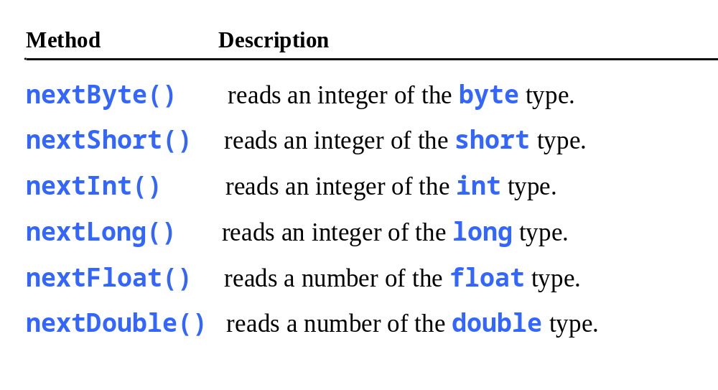
Reading Numbers from the Keyboard
Scanner input = new Scanner(System.in);
int value = input.nextInt();

Slide 23

Numeric Operators

Slide 24
Integer Division
+, -, *, /, and %
5 / 2 yields an integer 2.
5.0 / 2 yields a double value 2.5
5 % 2 yields 1 (the remainder of the division)

Slide 25

Remainder Operator
Remainder is very useful in programming. For example, an even number % 2 is always 0 and an odd number % 2 is always 1. So you can use this property to determine whether a number is even or odd. Suppose today is Saturday and you and your friends are going to meet in 10 days. What day is in 10 days? You can find that day is Tuesday using the following expression:

Slide 26
Problem: Displaying Time
Write a program that obtains minutes and remaining seconds from seconds.
DisplayTime
Run

Slide 27
NOTE
Calculations involving floating-point numbers are approximated because these numbers are not stored with complete accuracy. For example,
System.out.println(1.0 - 0.1 - 0.1 - 0.1 - 0.1 - 0.1);
displays 0.5000000000000001, not 0.5, and
System.out.println(1.0 - 0.9);
displays 0.09999999999999998, not 0.1. Integers are stored precisely. Therefore, calculations with integers yield a precise integer result.

Slide 28
Exponent Operations
System.out.println(Math.pow(2, 3));
// Displays 8.0
System.out.println(Math.pow(4, 0.5));
// Displays 2.0
System.out.println(Math.pow(2.5, 2));
// Displays 6.25
System.out.println(Math.pow(2.5, -2));
// Displays 0.16

Slide 29
Number Literals
A literal is a constant value that appears directly in the program. For example, 34, 1,000,000, and 5.0 are literals in the following statements:
int i = 34;
long x = 1000000;
double d = 5.0;

Slide 30
Integer Literals
An integer literal can be assigned to an integer variable as long as it can fit into the variable. A compilation error would occur if the literal were too large for the variable to hold. For example, the statement byte b = 1000 would cause a compilation error, because 1000 cannot be stored in a variable of the byte type.
An integer literal is assumed to be of the int type, whose value is between -2³¹ (-2147483648) to 2³¹–1 (2147483647). To denote an integer literal of the long type, append it with the letter L or l. L is preferred because l (lowercase L) can easily be confused with 1 (the digit one).

Slide 31
Floating-Point Literals
Floating-point literals are written with a decimal point. By default, a floating-point literal is treated as a double type value. For example, 5.0 is considered a double value, not a float value. You can make a number a float by appending the letter f or F, and make a number a double by appending the letter d or D. For example, you can use 100.2f or 100.2F for a float number, and 100.2d or 100.2D for a double number.

Slide 32
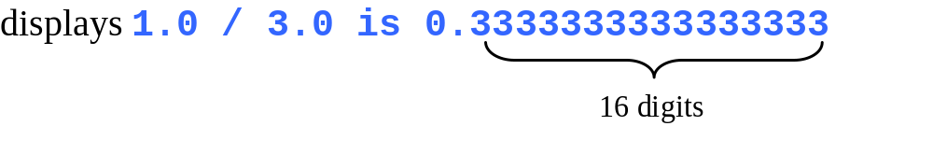
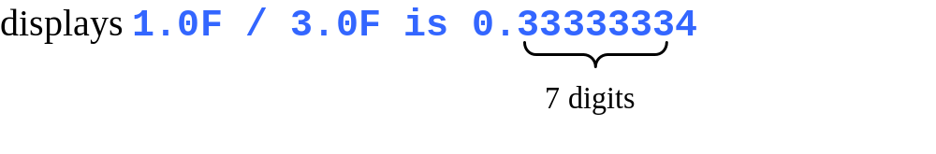
double vs. float
The double type values are more accurate than the float type values. For example,
System.out.println("1.0 / 3.0 is " + 1.0 / 3.0);
System.out.println("1.0F / 3.0F is " + 1.0F / 3.0F);

Slide 33
Scientific Notation
Floating-point literals can also be specified in scientific notation, for example, 1.23456e+2, same as 1.23456e2, is equivalent to 123.456, and 1.23456e-2 is equivalent to 0.0123456. E (or e) represents an exponent and it can be either in lowercase or uppercase.

Slide 34

Arithmetic Expressions
is translated to
(3+4*x)/5 – 10*(y-5)*(a+b+c)/x + 9*(4/x + (9+x)/y)

Slide 35

How to Evaluate an Expression
Though Java has its own way to evaluate an expression behind the scene, the result of a Java expression and its corresponding arithmetic expression are the same. Therefore, you can safely apply the arithmetic rule for evaluating a Java expression.

Slide 36

Problem: Converting Temperatures
Write a program that converts a Fahrenheit degree to Celsius using the formula:
Note: you have to write
celsius = (5.0 / 9) * (fahrenheit – 32)
FahrenheitToCelsius
Run

Slide 37

Problem: Displaying Current Time
Write a program that displays current time in GMT in the format hour:minute:second such as 1:45:19.
The currentTimeMillis method in the System class returns the current time in milliseconds since the midnight, January 1, 1970 GMT. (1970 was the year when the Unix operating system was formally introduced.) You can use this method to obtain the current time, and then compute the current second, minute, and hour as follows.
ShowCurrentTime
Run

Slide 38
Problem: Displaying Current Time
You can invoke System.currentTimeMillis() to return the current time.
The currentTimemillis method in the System class returns the current time in milliseconds elapsed since midnight, January 1, 1970 GMT, as shown in the figure. This time is known as the UNIX epoch. The epoch is the point when time starts, 1970 was the year when the UNIX OS was formally introduced.

Slide 39
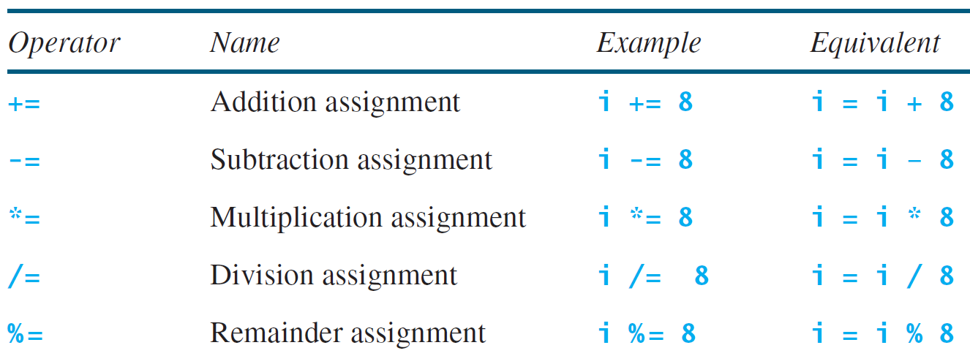
Augmented Assignment Operators

Slide 40
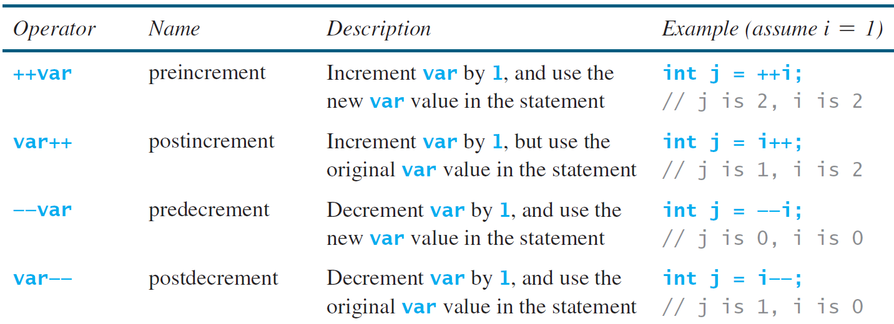
Increment and
Decrement Operators

Slide 41


Increment and
Decrement Operators, cont.

Slide 42
Increment and
Decrement Operators, cont.
Using increment and decrement operators makes expressions short, but it also makes them complex and difficult to read. Avoid using these operators in expressions that modify multiple variables, or the same variable for multiple times such as this: int k = ++i + i.

Slide 43
Assignment Expressions and Assignment Statements
Prior to Java 2, all the expressions can be used as statements. Since Java 2, only the following types of expressions can be statements:
variable op= expression; // Where op is +, -, *, /, or %
++variable;
variable++;
--variable;
variable--;

Slide 44
Numeric Type Conversion
Consider the following statements:
byte i = 100;
long k = i * 3 + 4;
double d = i * 3.1 + k / 2;

Slide 45
Conversion Rules
When performing a binary operation involving two operands of different types, Java automatically converts the operand based on the following rules:
1. If one of the operands is double, the other is converted into double.
2. Otherwise, if one of the operands is float, the other is converted into float.
3. Otherwise, if one of the operands is long, the other is converted into long.
4. Otherwise, both operands are converted into int.

Slide 46
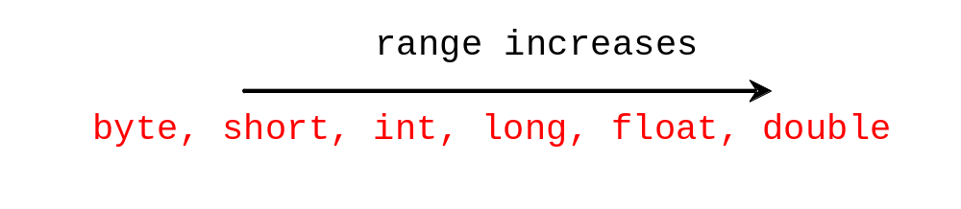
Type Casting
Implicit casting
double d = 3; (type widening)
Explicit casting
int i = (int)3.0; (type narrowing)
int i = (int)3.9; (Fraction part is truncated)
What is wrong? int x = 5 / 2.0;

Slide 47
Problem: Keeping Two Digits After Decimal Points
Write a program that displays the sales tax with two digits after the decimal point.
SalesTax
Run

Slide 48
Casting in an Augmented Expression
In Java, an augmented expression of the form x1 op= x2 is implemented as x1 = (T)(x1 op x2), where T is the type for x1. Therefore, the following code is correct.
int sum = 0;
sum += 4.5; // sum becomes 4 after this statement
sum += 4.5 is equivalent to sum = (int)(sum + 4.5).

Slide 49
Common Errors and Pitfalls
Common Error 1: Undeclared/Uninitialized Variables and Unused Variables
Common Error 2: Integer Overflow
Common Error 3: Round-off Errors
Common Error 4: Unintended Integer Division
Common Error 5: Redundant Input Objects
Common Pitfall 1: Redundant Input Objects

Slide 50
Common Error 1: Undeclared/Uninitialized Variables and Unused Variables
double interestRate = 0.05;
double interest = interestrate * 45;

Slide 51
Common Error 2: Integer Overflow
int value = 2147483647 + 1;
// value will actually be -2147483648

Slide 52
Common Error 3: Round-off Errors
System.out.println(1.0 - 0.1 - 0.1 - 0.1 - 0.1 - 0.1);
System.out.println(1.0 - 0.9);

Slide 53
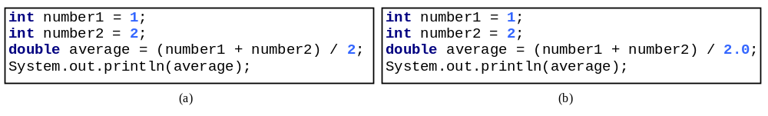
Common Error 4: Unintended Integer Division

Slide 54
Common Pitfall 1: Redundant Input Objects
Scanner input = new Scanner(System.in);
System.out.print("Enter an integer: ");
int v1 = input.nextInt();
Scanner input1 = new Scanner(System.in);
System.out.print("Enter a double value: ");
double v2 = input1.nextDouble();

